Slide 1
SC1004 Part 2
Lectured by Prof Guan Cuntai
(teaching materials by Prof Chng Eng Siong)
Email: ctguan@ntu.edu.sg

Slide 2
Quiz 2 and Exam:
Quiz 2
- Coverage: Ch 6 – 8.1.2
- Time & Venue:
Full-time students:
Time/Date: Week 13, last lecture time (10:30-11.20am, 17th April 2024, Wed)
Venue: LT1A, LT 7, LT 10, LT 11, LT 17
Part-time students:
Time/Date: Week 13, 7:30-8.20 pm, 16th April 2024, Tuesday
Venue: LHN-TR+15
2. Final Exam
- Coverage: Ch 6, 7, 8 (Q3 & Q4)
- Time/Venue: 2 May 2024 (Thursday), 1.00-3.00 pm, Hall W.
(Ch 9 will not be tested)

Slide 3
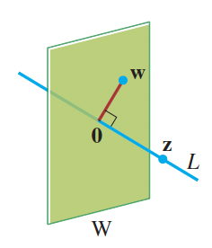
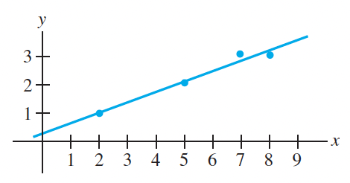
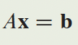
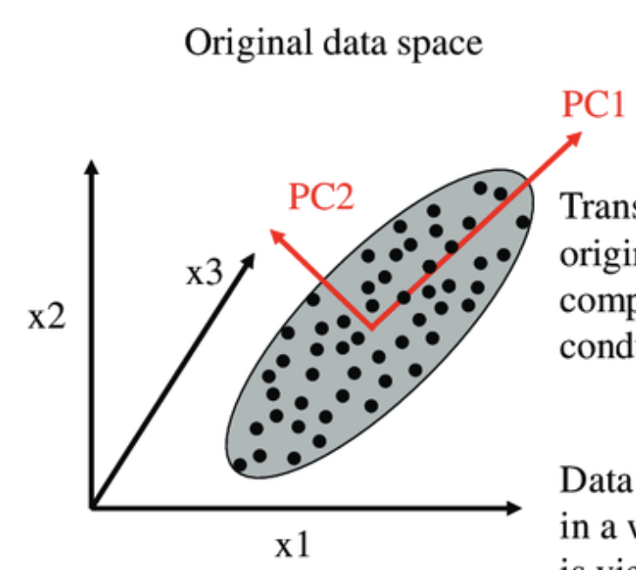
Syllabus for Part 2
Chapter | Topics | Week (Lecture) | Week (Tut)
6 | Orthogonality | 8-9 | 9-10
7 | Least Squares | 9-10 | 10-11
8 | EigenValue and Eigenvectors | 11-12 | 12-13
9 | Singular Value Decomposition (SVD) | 13
Table 1: schedule

Slide 4
Online Video learning Schedule
https://www.youtube.com/channel/UCBzG5jg3huxiPkCt-Serrjw
Week | Part | Topic | Notes
8 | 6.1.1-6.2.3 | Orthogonality, Normalization, Dot-Product, Inequalities, | Lecture 1: 6.1.1 - 6.1.3 Lecture 2: 6.1.4 - 6.2.3
9 | 6.2.4-6.3.2 | Orthogonal/Orthonormal Sets, Basis, Gram Schmidt and QR Decomposition | Lecture 3: 6.2.4 Lecture 4: 6.2.5 – 6.3.2
10 | 7.1.1-7.2.1 | Least Squares and Normal Eqn, Projection Matrix, Applications | Lecture 5: 7.1.1 – 7.1.3 Lecture 6: 7.1.4 – 7.2.1
11 | 8.1.1-8.1.2 | Eigenvectors, Eigen-values, Characteristics Eqn | Lecture 7: 8.1.1 Lecture 8: 8.1.2
12 | 8.1.3-8.1.5 | Diagonalisation, Power of A, Change of basis | Lecture 9: 8.1.3 Lecture 10: 8.1.4 – 8.1.5
13 | 9.1.1-9.2 | Introduction to SVD and PCA (Not examined in quiz/exam) | Lecture 11: 9.1.1 – 9.2 Lecture 12: Quiz 2

Slide 5
How will we conduct the course?
Before the lectures, watch the videos according to the schedule in Table 1
You can watch past years zoom video recordings at
https://www.youtube.com/@linearalgebra1884/playlists?view=50&sort=dd&shelf_id=2
During lecture hours –
We will summarize the lectures and highlight the key points
Q&A.

Slide 6
References

Slide 7
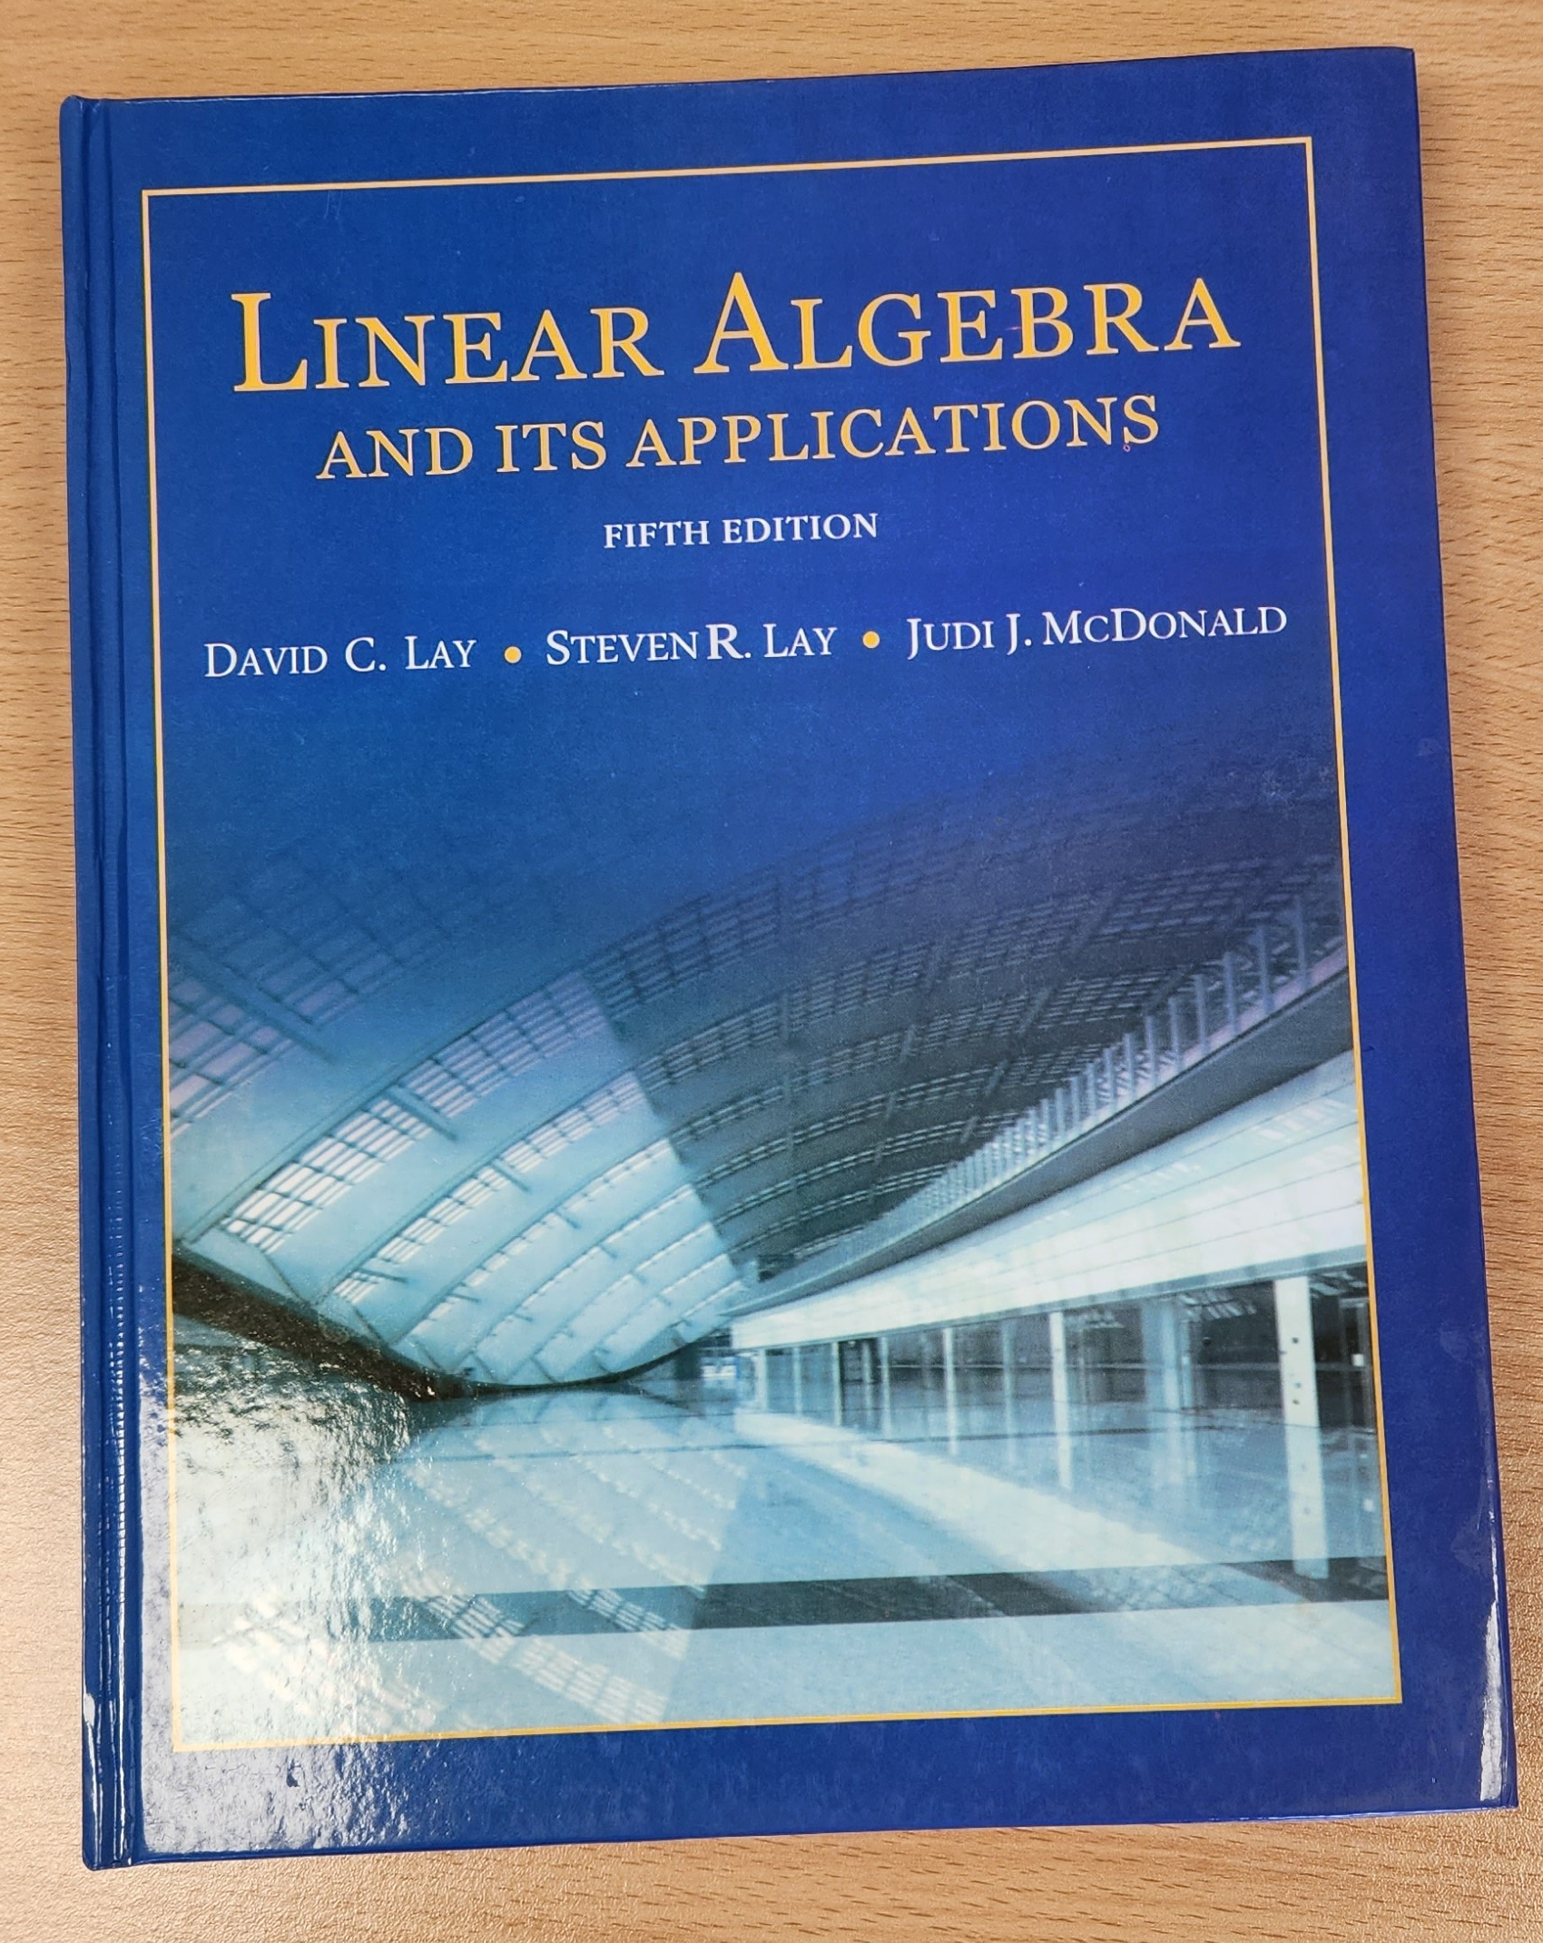

3Blue1Brown on YouTube
https://www.youtube.com/playlist?list=PLZHQObOWTQDPD3MizzM2xVFitgF8hE_ab
Linear Algebra and Its Applications
by David Lay, Steven Lay, Judi McDonald

Slide 8
Lecture (Week 13) (Chapter 9 & Revision)

Slide 9
9. Introduction to SVD & PCA
Singular Value Decomposition (SVD)
Principal Component Analysis (PCA)

Slide 10
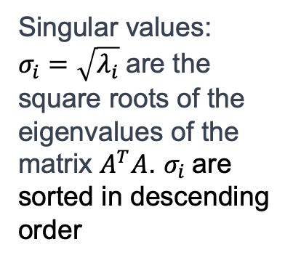
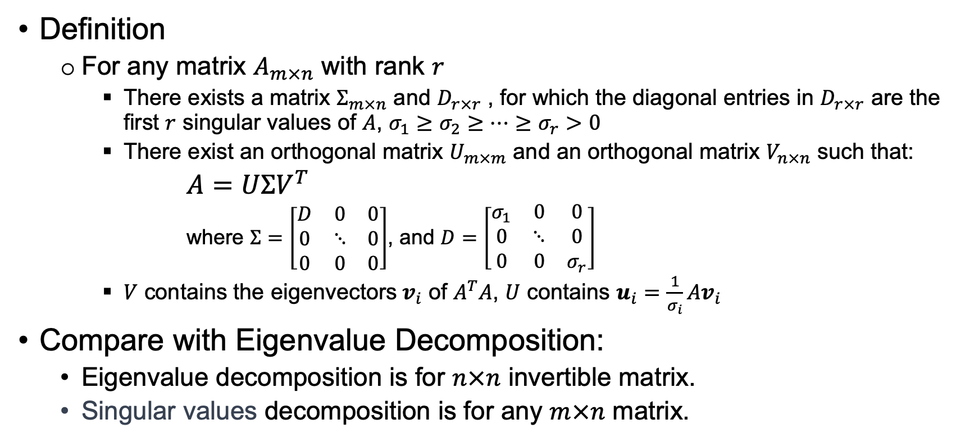
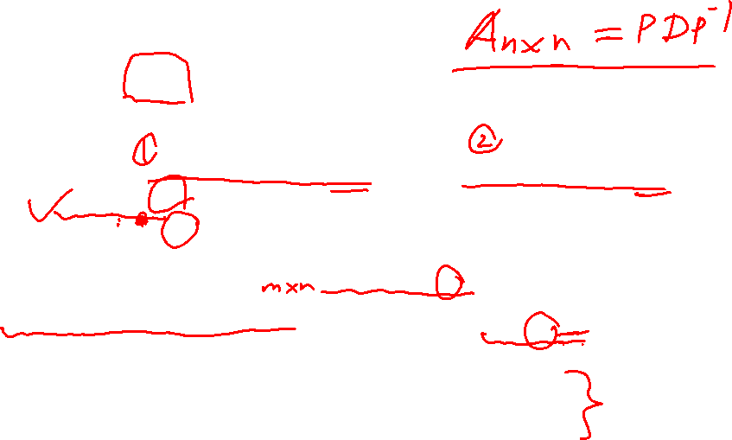
9.1.1 Singular Value Decomposition (SVD)
Definition
For any matrix $A_{m×n}$ with rank $r$
There exists a matrix $Σ_{m×n}$ and $D_{r×r}$ , for which the diagonal entries in $D_{r×r}$ are the first $r$ singular values of $A$, $σ_{1}≥σ_{2}≥⋯≥σ_{r}>0$
There exist an orthogonal matrix $U_{m×m}$ and an orthogonal matrix $V_{n×n}$ such that:
$A=UΣV^{T}$
where $Σ=\left[\begin{matrix}D & 0 & 0 \\ 0 & ⋱ & 0 \\ 0 & 0 & 0\end{matrix}\right]$, and $D=\left[\begin{matrix}σ_{1} & 0 & 0 \\ 0 & ⋱ & 0 \\ 0 & 0 & σ_{r}\end{matrix}\right]$
$V$ contains the eigenvectors $v_{i}$ of $A^{T}A$, $U$ contains $u_{i}=\frac{1}{σ_{i}}Av_{i}$
Compare with Eigenvalue Decomposition:
Eigenvalue decomposition is for $n×n$ invertible matrix.
Singular values decomposition is for any $m×n$ matrix.
Singular values:
$σ_{i}=\sqrt{λ_{i}}$are the square roots of the eigenvalues of the matrix $A^{T}A$. $σ_{i}$are sorted in descending order

Slide 11
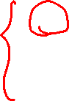
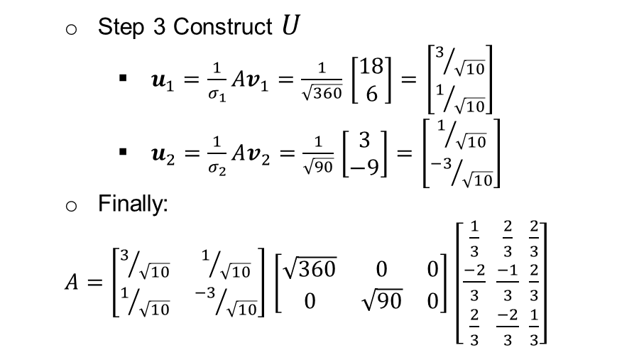
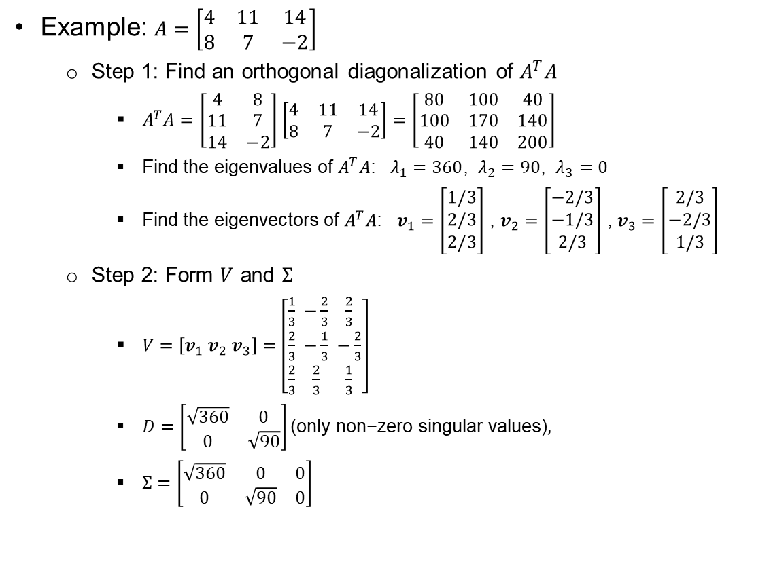
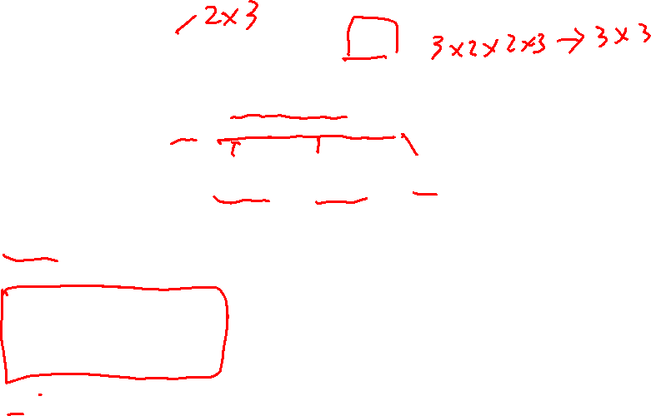

9.1.2 Find Singular Value Decomposition
Example: $A=\left[\begin{matrix}4 & 11 & 14 \\ 8 & 7 & −2\end{matrix}\right]$
Step 1: Find an orthogonal diagonalization of $A^{T}A$
$A^{T}A=$ $\left[\begin{matrix}4 & 8 \\ 11 & 7 \\ 14 & −2\end{matrix}\right]$ $\left[\begin{matrix}4 & 11 & 14 \\ 8 & 7 & −2\end{matrix}\right]=\left[\begin{matrix}80 & 100 & 40 \\ 100 & 170 & 140 \\ 40 & 140 & 200\end{matrix}\right]$
Find the eigenvalues of $A^{T}A$: $λ_{1}=360$, $λ_{2}=90$, $λ_{3}=0$
Find the eigenvectors of $A^{T}A$: $v_{1}=\left[\begin{matrix}1/3 \\ 2/3 \\ 2/3\end{matrix}\right]$ , $v_{2}=\left[\begin{matrix}−2/3 \\ −1/3 \\ 2/3\end{matrix}\right]$ , $v_{3}=\left[\begin{matrix}2/3 \\ −2/3 \\ 1/3\end{matrix}\right]$
Step 2: Form $V$ and $Σ$
$V=\left[v_{1}{ v}_{2}{ v}_{3}\right]=\left[\begin{matrix}\frac{1}{3} \\ \frac{2}{3} \\ \frac{2}{3}\end{matrix} \begin{matrix}−\frac{2}{3} \\ −\frac{1}{3} \\ \frac{2}{3}\end{matrix} \begin{matrix}\frac{2}{3} \\ −\frac{2}{3} \\ \frac{1}{3}\end{matrix}\right]$
$D=\left[\begin{matrix}\sqrt{360} & 0 \\ 0 & \sqrt{90}\end{matrix}\right]\text{(}\text{only} \text{non}\text{−}\text{zero} \text{singular} \text{values}\text{)},$
$Σ=\left[\begin{matrix}\sqrt{360} & 0 & 0 \\ 0 & \sqrt{90} & 0\end{matrix}\right]$
Step 3 Construct $U$
$u_{1}=\frac{1}{σ_{1}}Av_{1}=\frac{1}{\sqrt{360}}$ $\left[\begin{matrix}18 \\ 6\end{matrix}\right]=$ $\left[\begin{matrix}3/{\sqrt{10}} \\ 1/{\sqrt{10}}\end{matrix}\right]$
$u_{2}=\frac{1}{σ_{2}}Av_{2}=\frac{1}{\sqrt{90}}$ $\left[\begin{matrix}3 \\ −9\end{matrix}\right]=$ $\left[\begin{matrix}1/{\sqrt{10}} \\ {−3}/{\sqrt{10}}\end{matrix}\right]$
Finally:
$A=\left[\begin{matrix}3/{\sqrt{10}} & 1/{\sqrt{10}} \\ 1/{\sqrt{10}} & {−3}/{\sqrt{10}}\end{matrix}\right]$ $\left[\begin{matrix}\sqrt{360} & 0 & 0 \\ 0 & \sqrt{90} & 0\end{matrix}\right]$ $\left[\begin{matrix}\frac{1}{3} \\ \frac{−2}{3} \\ \frac{2}{3}\end{matrix} \begin{matrix}\frac{2}{3} \\ \frac{−1}{3} \\ \frac{−2}{3}\end{matrix} \begin{matrix}\frac{2}{3} \\ \frac{2}{3} \\ \frac{1}{3}\end{matrix}\right]$
$$A=UΣV^{T}$$

Slide 12
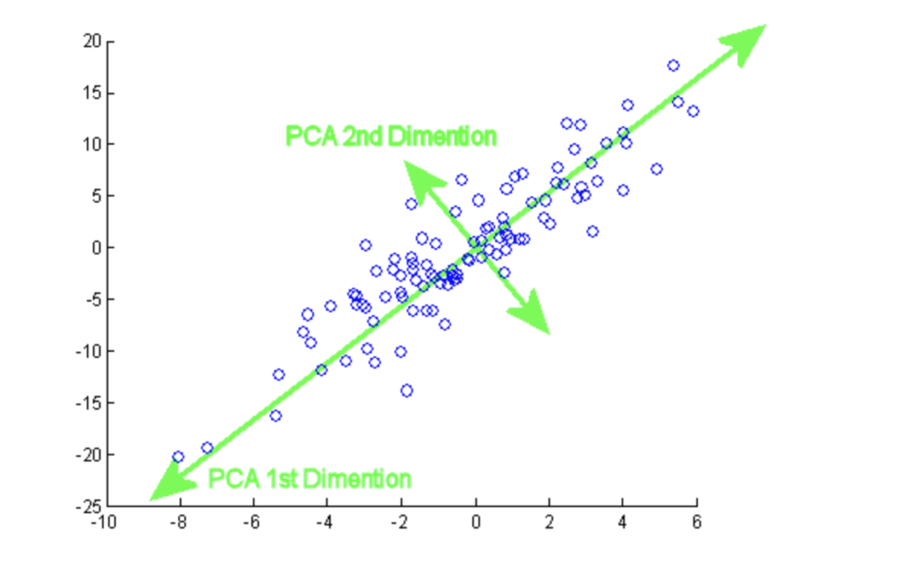
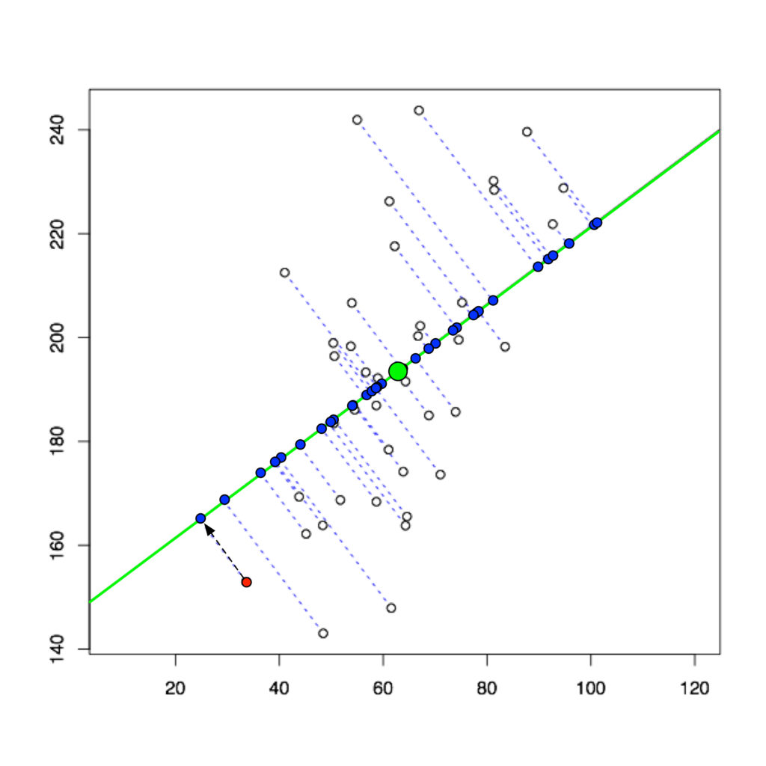
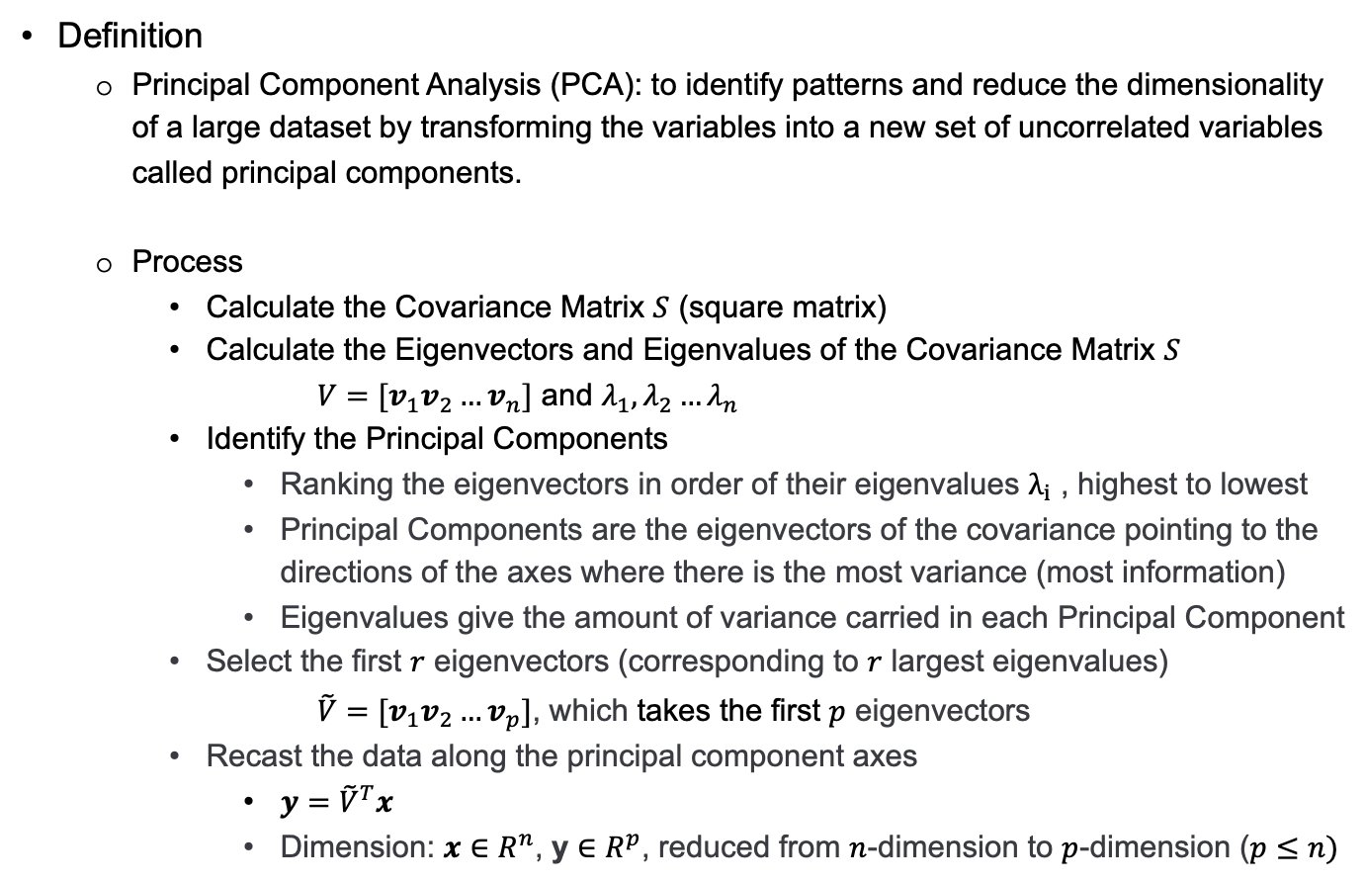
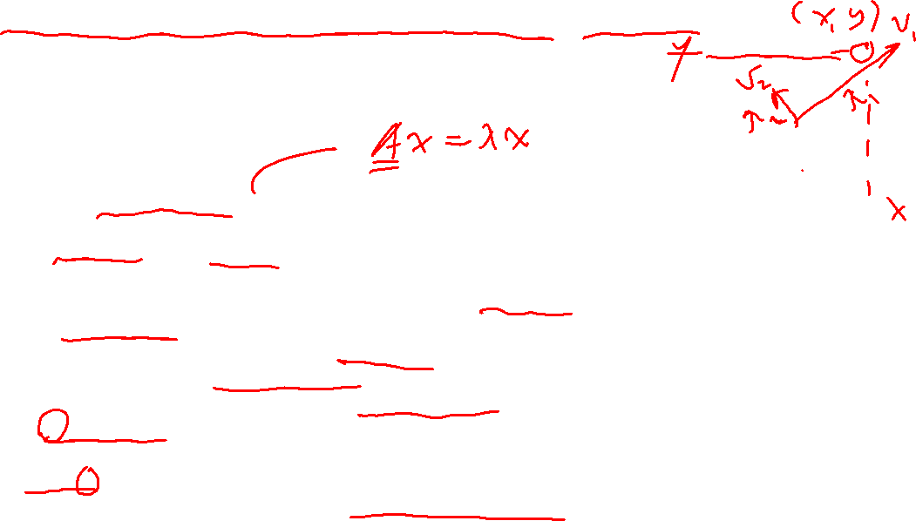
9.2 Principal Component Analysis (PCA)
Definition
Principal Component Analysis (PCA): to identify patterns and reduce the dimensionality of a large dataset by transforming the variables into a new set of uncorrelated variables called principal components.
Process
Calculate the Covariance Matrix $S$ (square matrix)
Calculate the Eigenvectors and Eigenvalues of the Covariance Matrix $S$
$V=[v_{1}v_{2}…v_{n}]$ and $λ_{1},λ_{2}…λ_{n}$
Identify the Principal Components
Ranking the eigenvectors in order of their eigenvalues $λ_{i}$ , highest to lowest
Principal Components are the eigenvectors of the covariance pointing to the directions of the axes where there is the most variance (most information)
Eigenvalues give the amount of variance carried in each Principal Component
Select the first $r$ eigenvectors (corresponding to $r$ largest eigenvalues)
$\tilde{V}=[v_{1}v_{2}…v_{p}]$, which takes the first $p$ eigenvectors
Recast the data along the principal component axes
$y={\tilde{V}}^{T}x$
Dimension: $x∈R^{n}$, y $∈R^{p}$, reduced from $n$-dimension to $p$-dimension ($p≤n)$

Slide 13
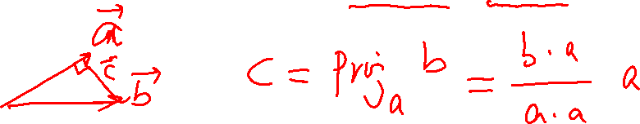
Revision
Apr/May 2021

Slide 14
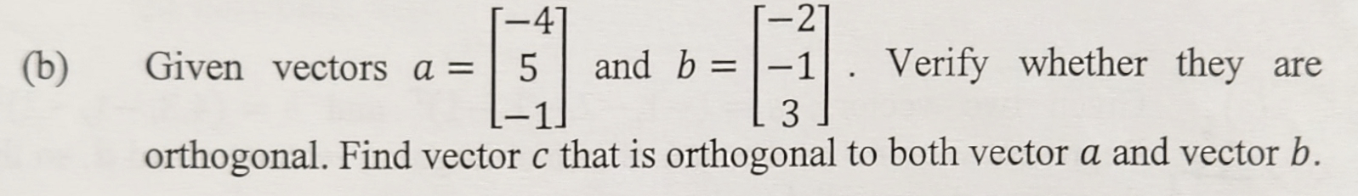
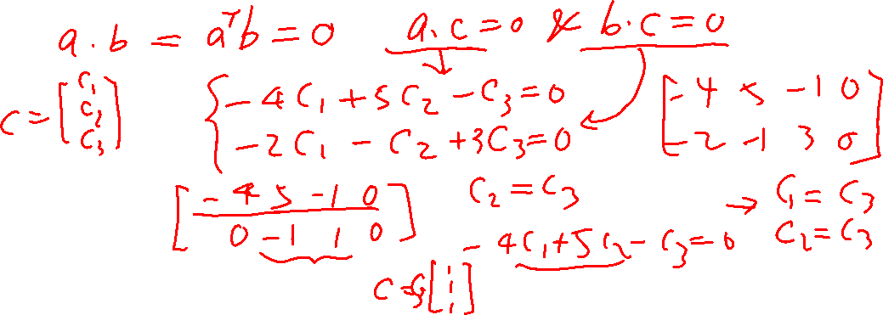
Revision
Apr/May 2021

Slide 15
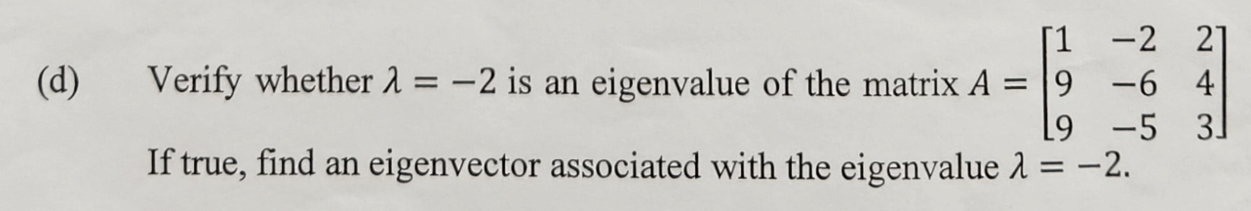
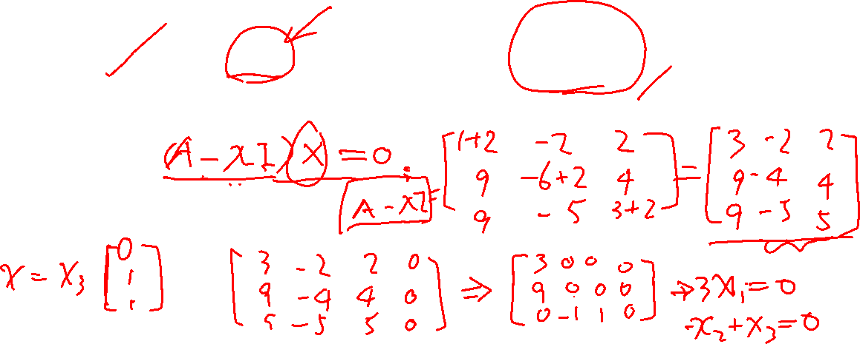
Revision
Apr/May 2021

Slide 16
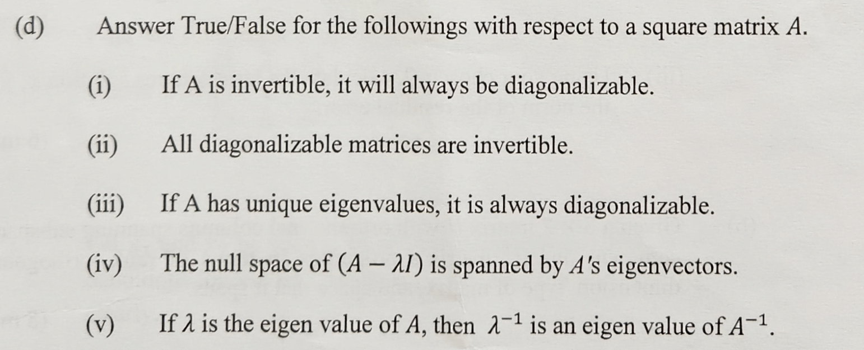
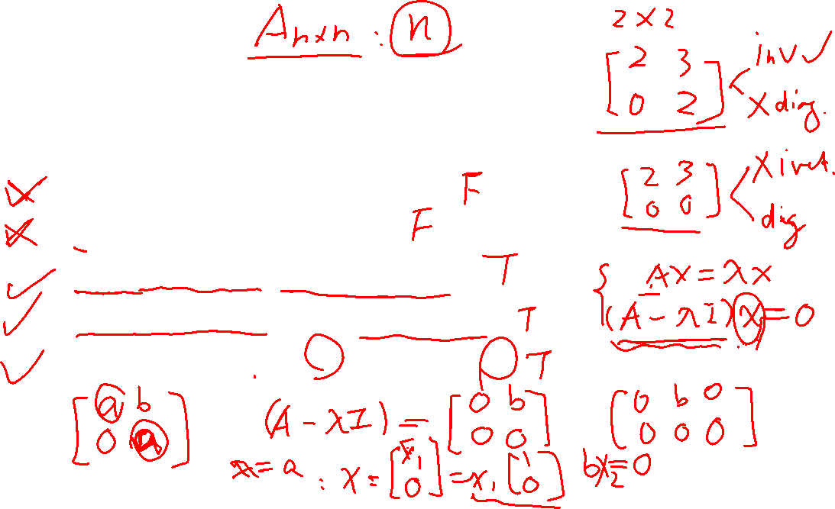
Revision
Nov/Dec 2021

Slide 17
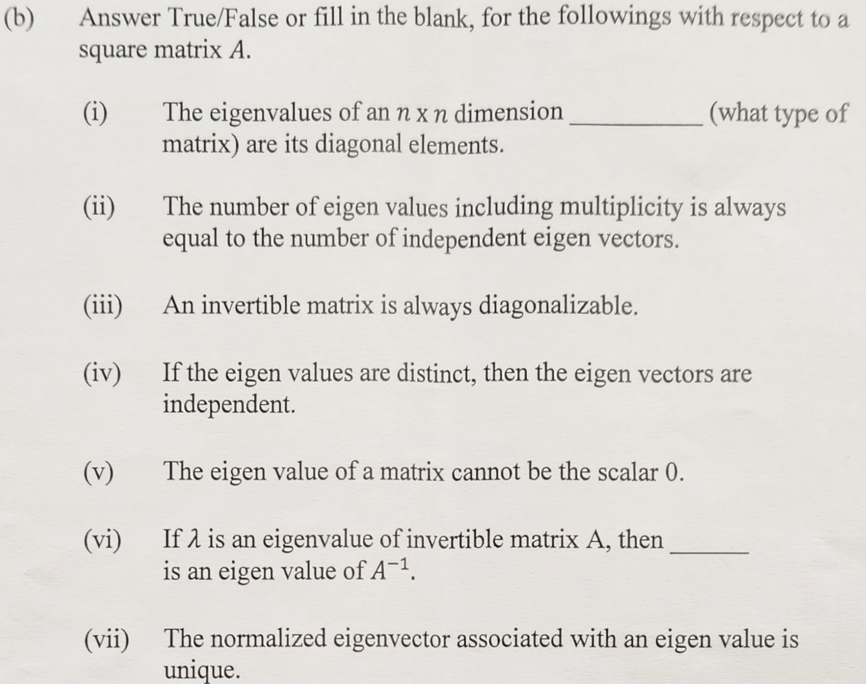
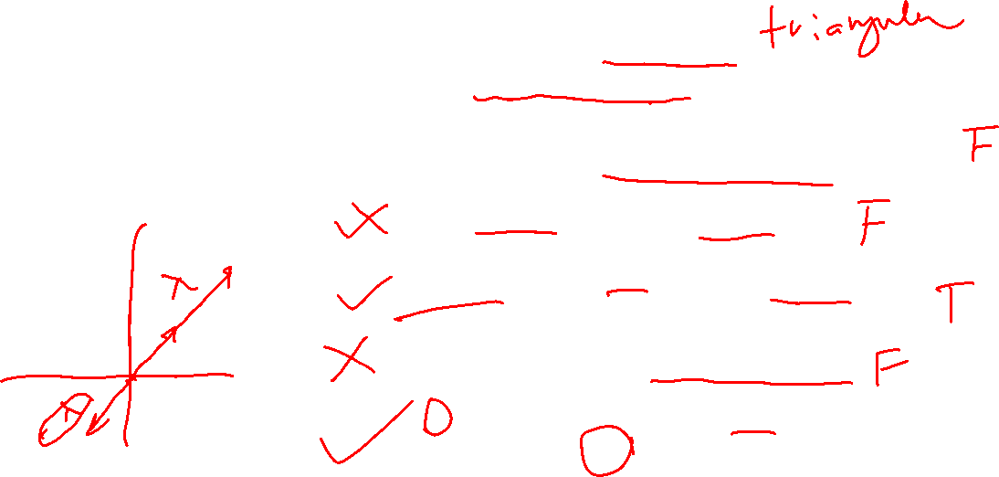
Revision
Nov/Dec 2022

Slide 18
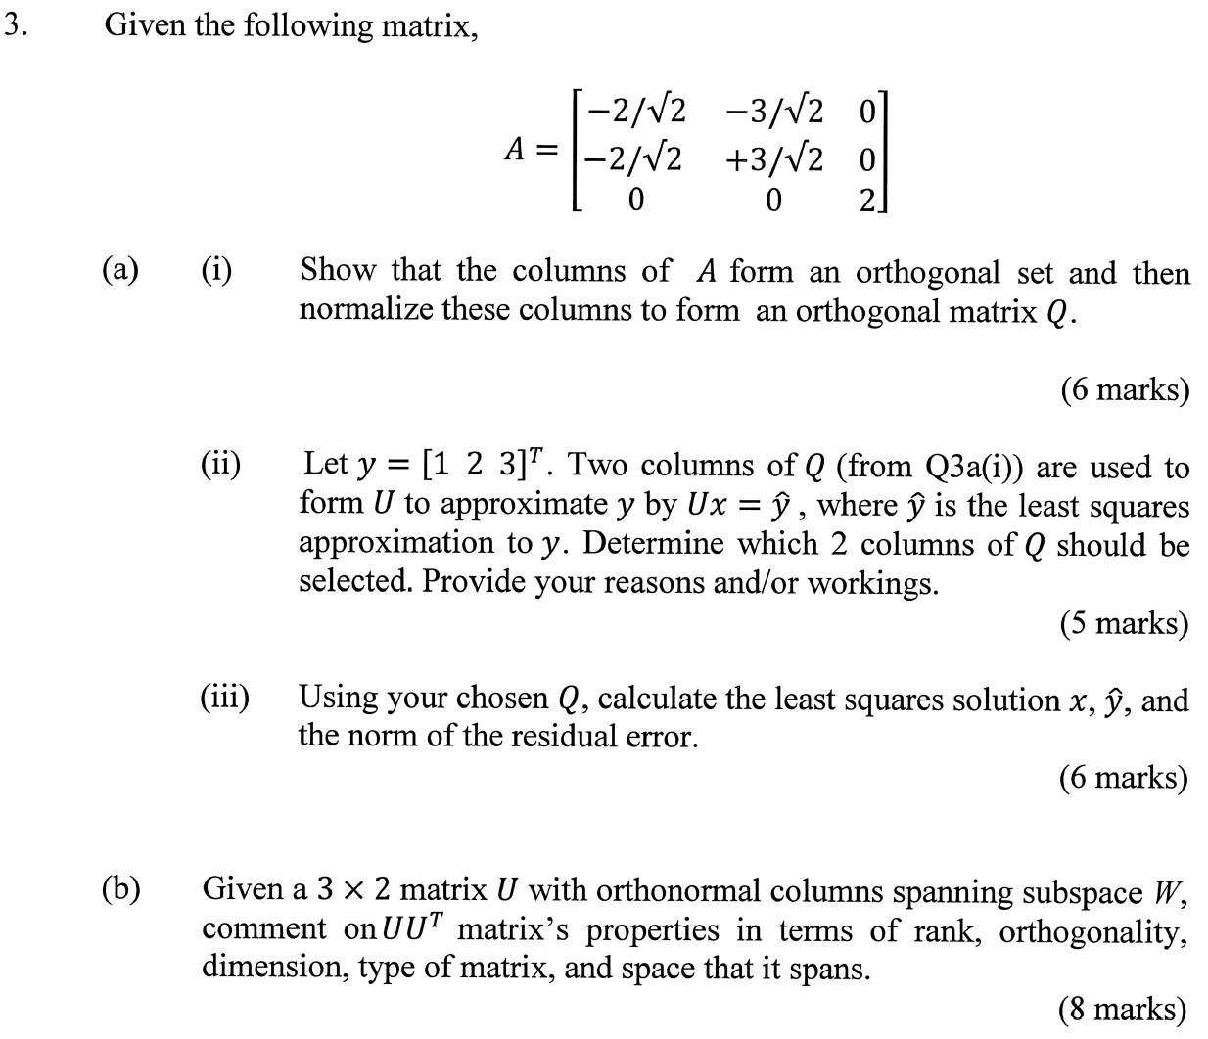
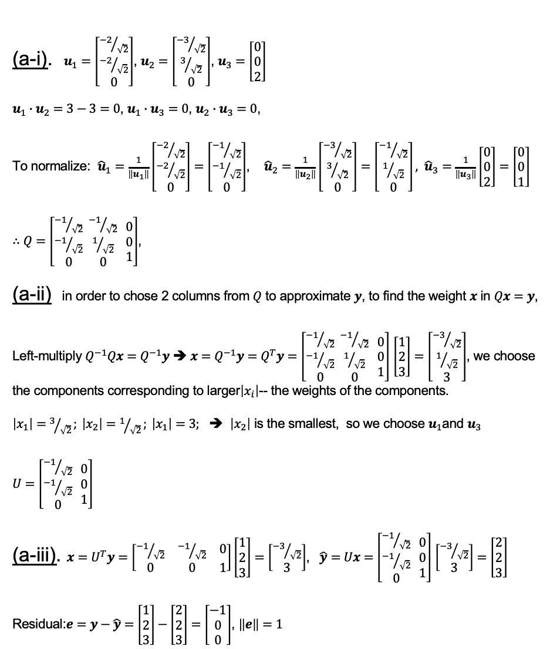
Revision
(a-i). $u_{1}=\left[\begin{matrix}{−2}/{\sqrt{2}} \\ {−2}/{\sqrt{2}} \\ 0\end{matrix}\right]$, $u_{2}=\left[\begin{matrix}{−3}/{\sqrt{2}} \\ 3/{\sqrt{2}} \\ 0\end{matrix}\right]$, $u_{3}=\left[\begin{matrix}0 \\ 0 \\ 2\end{matrix}\right]$
$u_{1}∙u_{2}=3−3=0$, $u_{1}∙u_{3}=0$, $u_{2}∙u_{3}=0$,
To normalize: ${\hat{u}}_{1}=\frac{1}{\left\|u_{1}\right\|}\left[\begin{matrix}{−2}/{\sqrt{2}} \\ {−2}/{\sqrt{2}} \\ 0\end{matrix}\right]=$ $\left[\begin{matrix}{−1}/{\sqrt{2}} \\ {−1}/{\sqrt{2}} \\ 0\end{matrix}\right]$, ${\hat{u}}_{2}=\frac{1}{\left\|u_{2}\right\|}\left[\begin{matrix}{−3}/{\sqrt{2}} \\ 3/{\sqrt{2}} \\ 0\end{matrix}\right]=$ $\left[\begin{matrix}{−1}/{\sqrt{2}} \\ 1/{\sqrt{2}} \\ 0\end{matrix}\right], {\hat{u}}_{3}=\frac{1}{\left\|u_{3}\right\|}\left[\begin{matrix}0 \\ 0 \\ 2\end{matrix}\right]=$ $\left[\begin{matrix}0 \\ 0 \\ 1\end{matrix}\right]$
$∴Q=\left[\begin{matrix}{−1}/{\sqrt{2}} \\ {−1}/{\sqrt{2}} \\ 0\end{matrix} \begin{matrix}{−1}/{\sqrt{2}} \\ 1/{\sqrt{2}} \\ 0\end{matrix} \begin{matrix}0 \\ 0 \\ 1\end{matrix}\right]$,
(a-ii) in order to chose 2 columns from $Q$ to approximate $y$, to find the weight $x$ in $Qx=y$,
Left-multiply $Q^{−1}Qx=Q^{−1}y$ ➔ $x=Q^{−1}y=Q^{T}y=$ $\left[\begin{matrix}{−1}/{\sqrt{2}} \\ {−1}/{\sqrt{2}} \\ 0\end{matrix} \begin{matrix}{−1}/{\sqrt{2}} \\ 1/{\sqrt{2}} \\ 0\end{matrix} \begin{matrix}0 \\ 0 \\ 1\end{matrix}\right]$ $\left[\begin{matrix}1 \\ 2 \\ 3\end{matrix}\right]=\left[\begin{matrix}{−3}/{\sqrt{2}} \\ 1/{\sqrt{2}} \\ 3\end{matrix}\right]$, we choose the components corresponding to larger$\left|x_{i}\right|$-- the weights of the components.
$\left|x_{1}\right|=$ $3/{\sqrt{2}}; \left|x_{2}\right|=$ $1/{\sqrt{2}}; \left|x_{1}\right|=$ $3;$ ➔ $\left|x_{2}\right|$ is the smallest, so we choose $u_{1}$and $u_{3}$
$U=$ $\left[\begin{matrix}{−1}/{\sqrt{2}} \\ {−1}/{\sqrt{2}} \\ 0\end{matrix} \begin{matrix}0 \\ 0 \\ 1\end{matrix}\right]$
(a-iii). $x=U^{T}y=\left[\begin{matrix}{−1}/{\sqrt{2}} & {−1}/{\sqrt{2}} & 0 \\ 0 & 0 & 1\end{matrix}\right]\left[\begin{matrix}1 \\ 2 \\ 3\end{matrix}\right]=\left[\begin{matrix}{−3}/{\sqrt{2}} \\ 3\end{matrix}\right]$, $\hat{y}=$ $Ux=$ $\left[\begin{matrix}{−1}/{\sqrt{2}} \\ {−1}/{\sqrt{2}} \\ 0\end{matrix} \begin{matrix}0 \\ 0 \\ 1\end{matrix}\right]$ $\left[\begin{matrix}{−3}/{\sqrt{2}} \\ 3\end{matrix}\right]=$ $\left[\begin{matrix}2 \\ 2 \\ 3\end{matrix}\right]$
Residual:$e=y−\hat{y}=$ $\left[\begin{matrix}1 \\ 2 \\ 3\end{matrix}\right]−\left[\begin{matrix}2 \\ 2 \\ 3\end{matrix}\right]=\left[\begin{matrix}−1 \\ 0 \\ 0\end{matrix}\right]$, $\left\|e\right\|=1$
Nov/Dec 2021

Slide 19
End

